Slide 2

College Admission Application

Slide 3

Agenda
Introduction
Objective
SDLC
MongoDB Compass
Jira Dashboard

Slide 4

INTRODUCTION
Creating a structured and efficient method for student registration is crucial for educational institutions.
By designing a web application with a detailed form, colleges can collect essential information such as personal details, academic background, and contact information.
This not only simplifies the registration process for students but also aids in maintaining organized records for the institution.

Slide 5
Objective
To provide a user-friendly interface for students to enter and submit their personal and academic details for college registration purposes.
This form handles invalid inputs gracefully and provides appropriate error messages.
Designing a simple console-based Java program for the students to enter the details.
Communicating with a NodeJS server to store and retrieve student application data

Slide 6
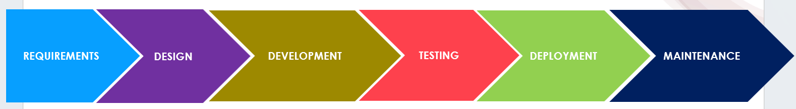
SDLC(AGILE METHODOLOGY)

Slide 7

REQUIREMENT PHASE
Extend the Node JS application to interact with a database server. The server should store and retrieve student’s details from the database and perform the testing (QA/QC) using SDLC and update the status using Jira Tool.
Ensure the program maintains functionality to store information like Application date, Student Name, Surname, Gender, Dob, Father name, Appearing for class (first year, second year), Stream, Previous school details, Permanent Address, Present Address.

Slide 8
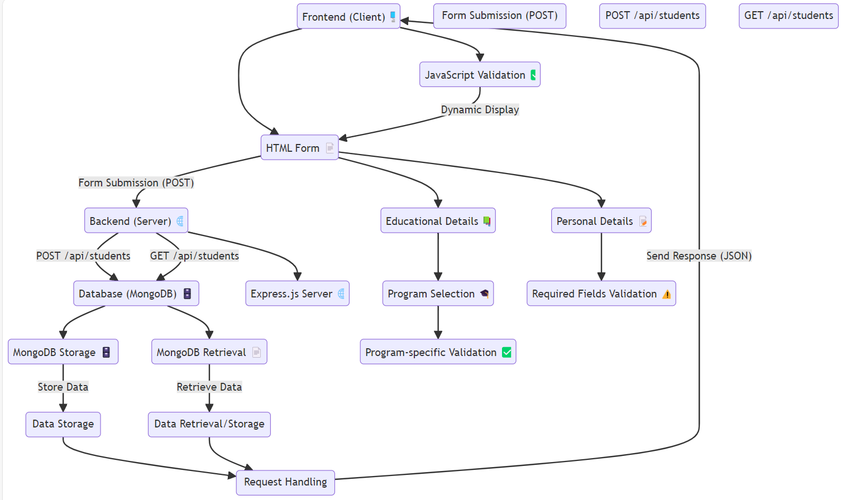
DESIGN PHASE

Slide 9

Project Directory Structure
student-application/
── backend/
→server.js
→ package.json
→package-lock. Json
── frontend/
→ index.html
→ form.html
→contactUs.html
→aboutUs.html
→ styles.css
→script.js

Slide 10
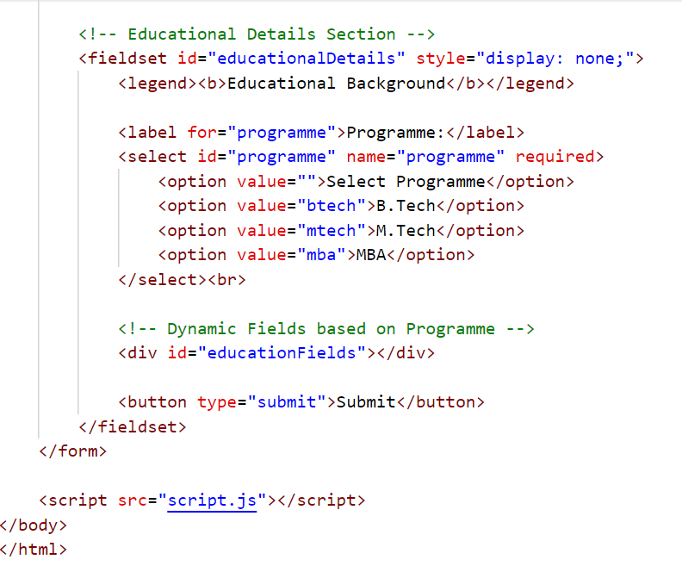
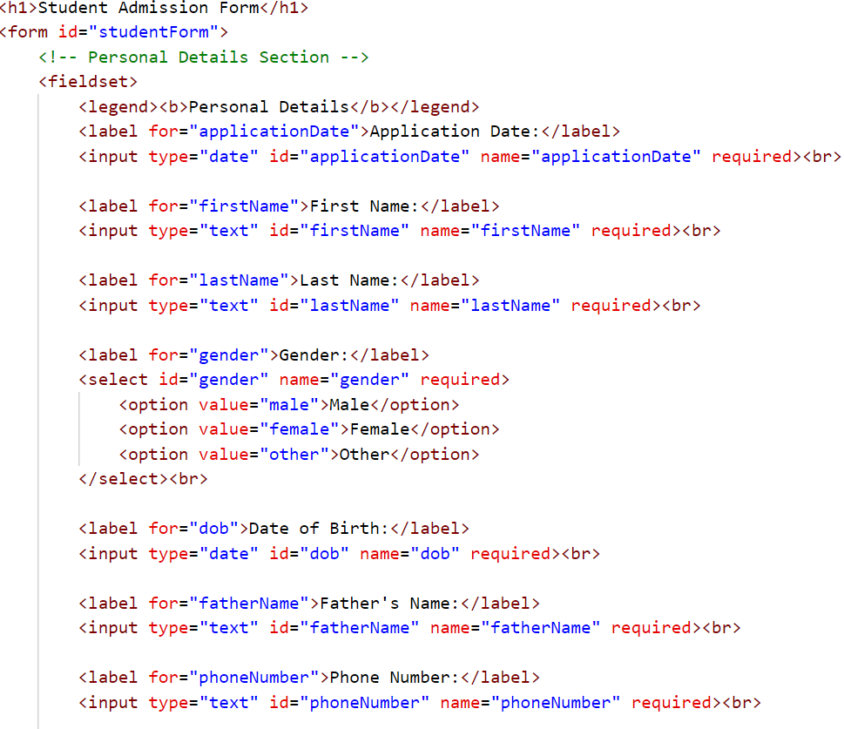
DEVELOPMENT PHASE
Form.html

Slide 11
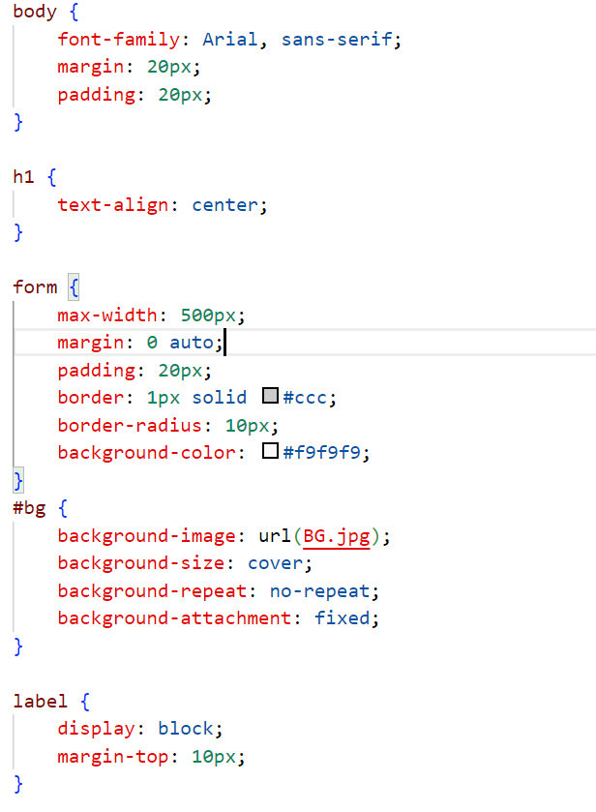
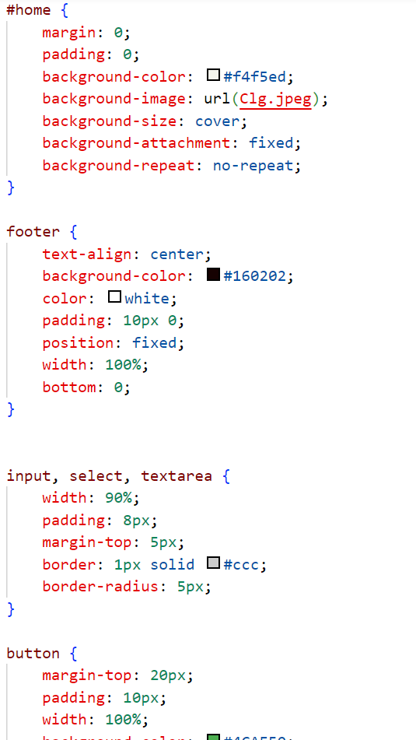
DEVELOPMENT PHASE
Styles.css

Slide 12
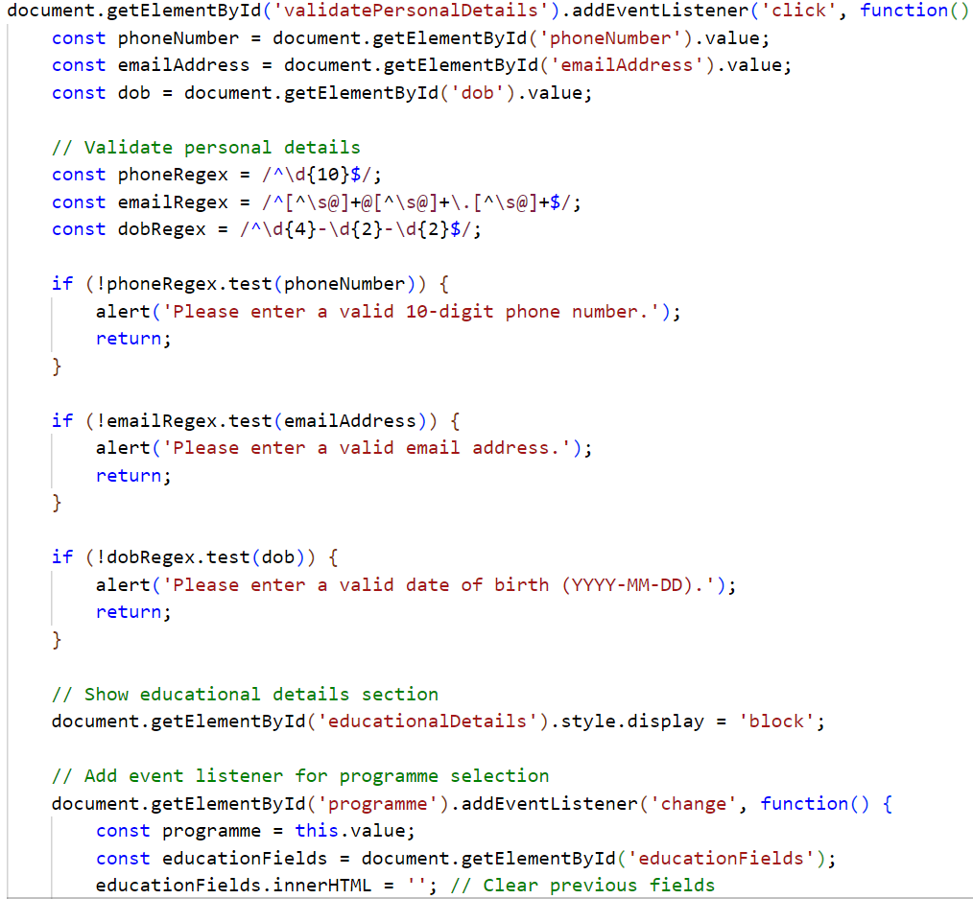
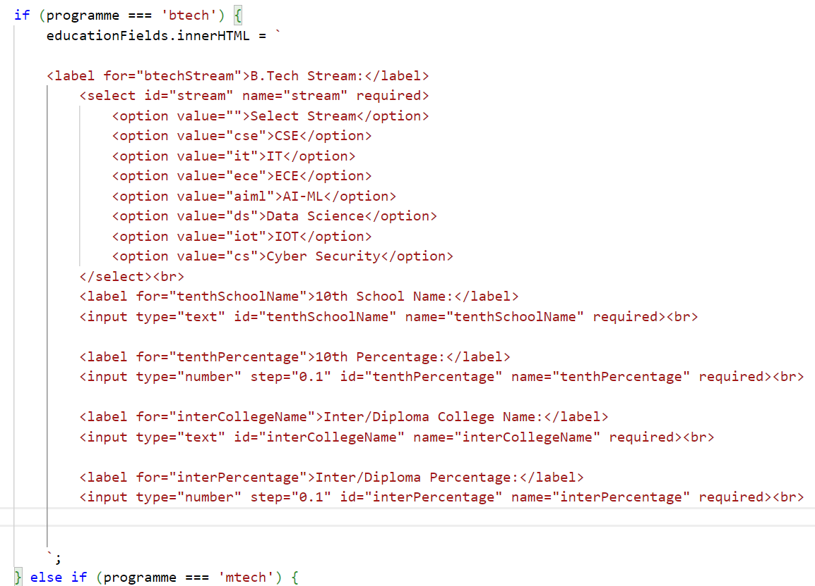
script.js

Slide 13
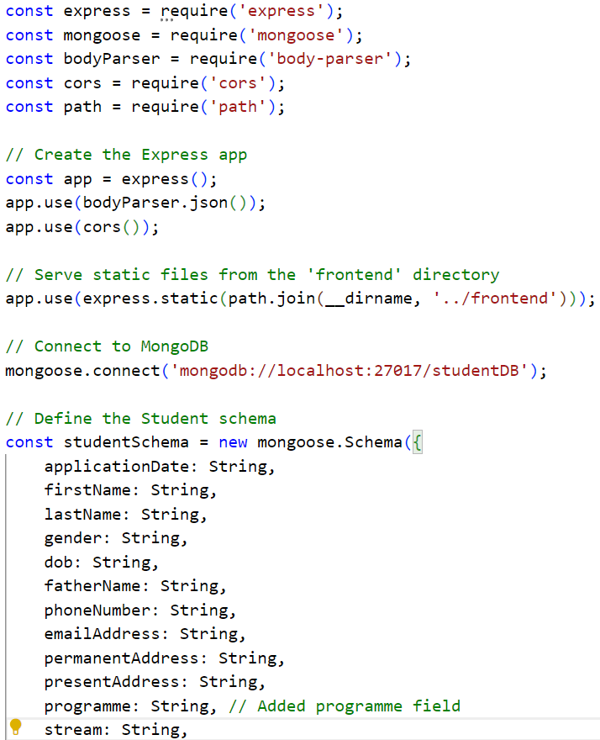
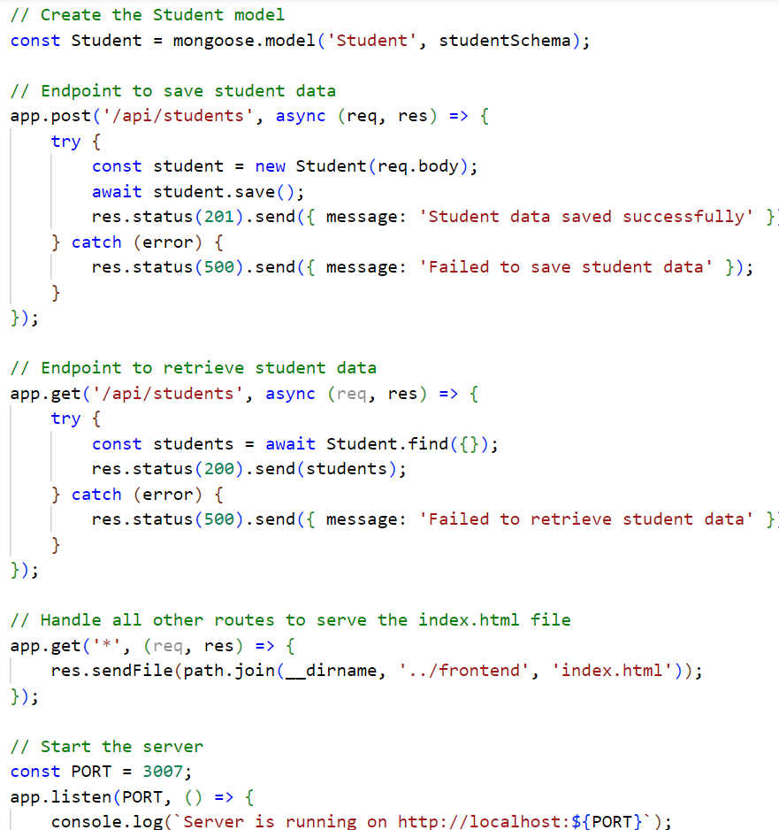
server.js(backend)

Slide 14
TESTING PHASE
Test Case ID | Action Performed | Expected Result
TC001 | Open the student admission form in the browser | The form should be displayed with personal details section visible
TC002 | Enter a valid 10-digit phone number and click "Validate" | The educational details section should be displayed
TC003 | Enter an invalid email address (e.g., "user@.com") and click "Validate" | An error message should be shown: "Please enter a valid email address."
TC004 | Enter a valid date of birth in the format YYYY-MM-DD and click "Validate" | The educational details section should be displayed
TC005 | Enter an invalid date of birth (e.g., "12-31-2000") and click "Validate" | An error message should be shown: "Please enter a valid date of birth (YYYY-MM-DD)."
TC006 | Select "B.Tech" from the "Programme" dropdown | Fields specific to B.Tech should be displayed under the educational details section
TC007 | Select "MTech" from the "Programme" dropdown | Fields specific to M.Tech should be displayed under the educational details section
TC008 | Select "MBA" from the "Programme" dropdown | Fields specific to MBA should be displayed under the educational details section

Slide 15
TC009 | Submit the form with all fields filled correctly | The student data should be saved, and a success message should be shown: "Student data saved successfully"
TC010 | Submit the form with missing required fields | An error message should be shown: "Please fill out this field."
TC011 | Open the API endpoint /api/students | The endpoint should return a list of all saved student records in JSON format
TC012 | Submit a form with invalid data (e.g., text in numeric fields) | The form should not be submitted, and an error message should be shown
TC013 | Submit the form and check MongoDB for stored data | The student data should be correctly stored in MongoDB with all fields
TC014 | Check if the stream field is correctly stored in MongoDB | The stream field should match the selected stream from the form
TC015 | Test form submission without selecting a programme | An error message should be shown: "Please select a programme"
TC016 | Access a non-existent endpoint (e.g., /api/unknown) | A 404-error message should be returned

Slide 16
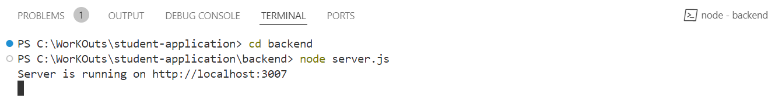
DEPLOYMENT PHASE
1.Start your server

Slide 17
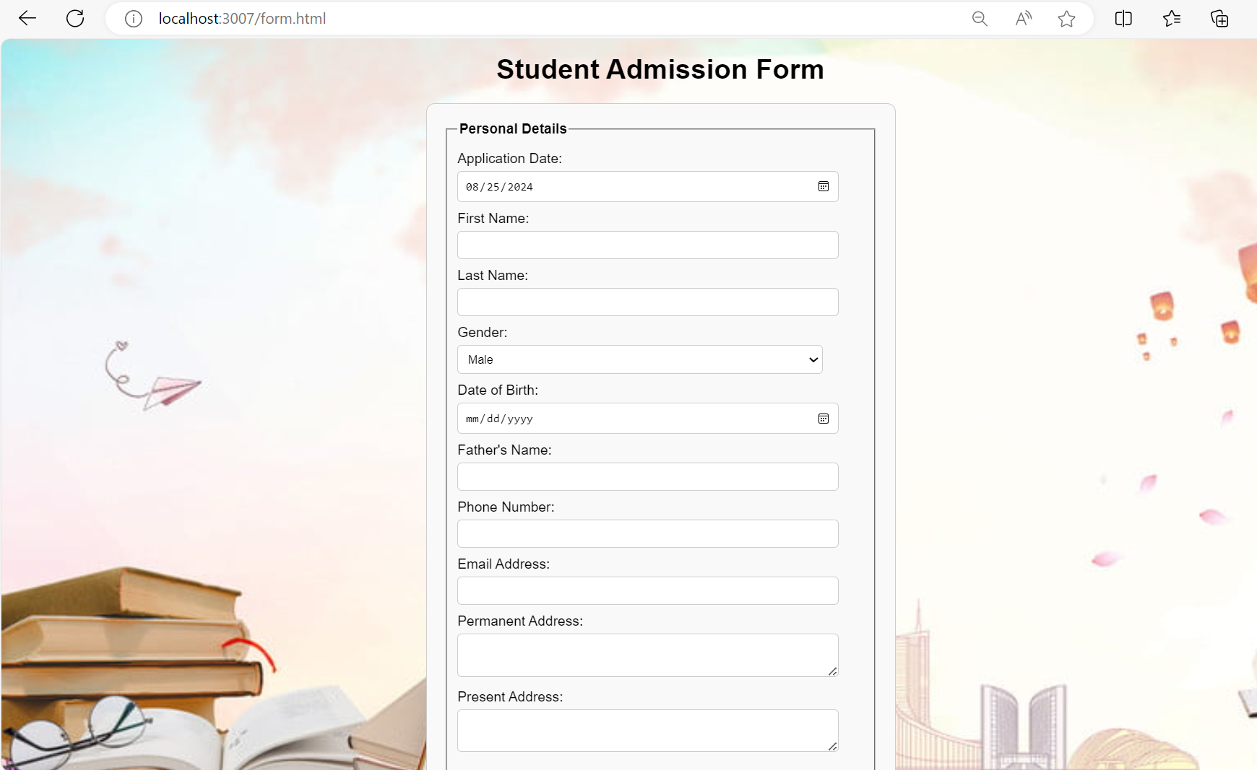
DEPLOYMENT PHASE
2.Access the application: http://localhost:3007
:

Slide 18
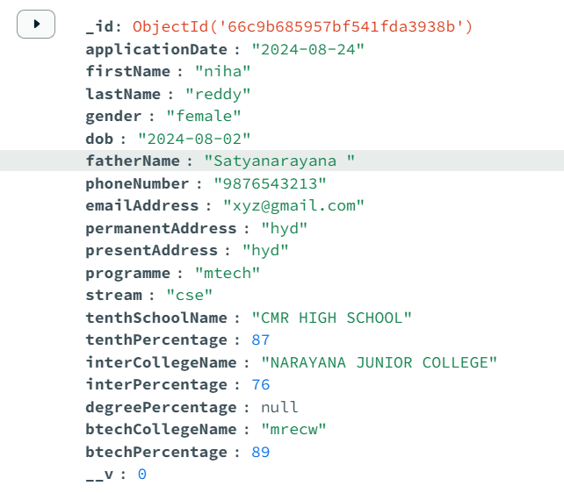
DEPLOYMENT PHASE
3.Ensure that the data is correctly stored in the database(MongoDB)

Slide 19
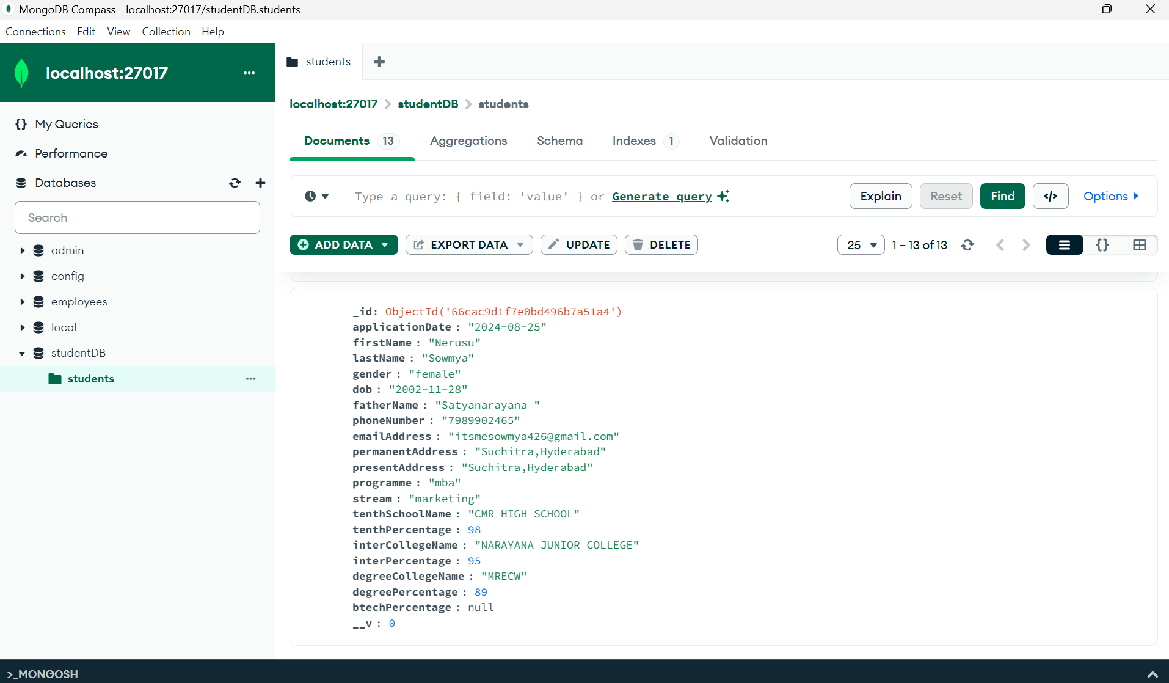
MongoDB Compass

Slide 20
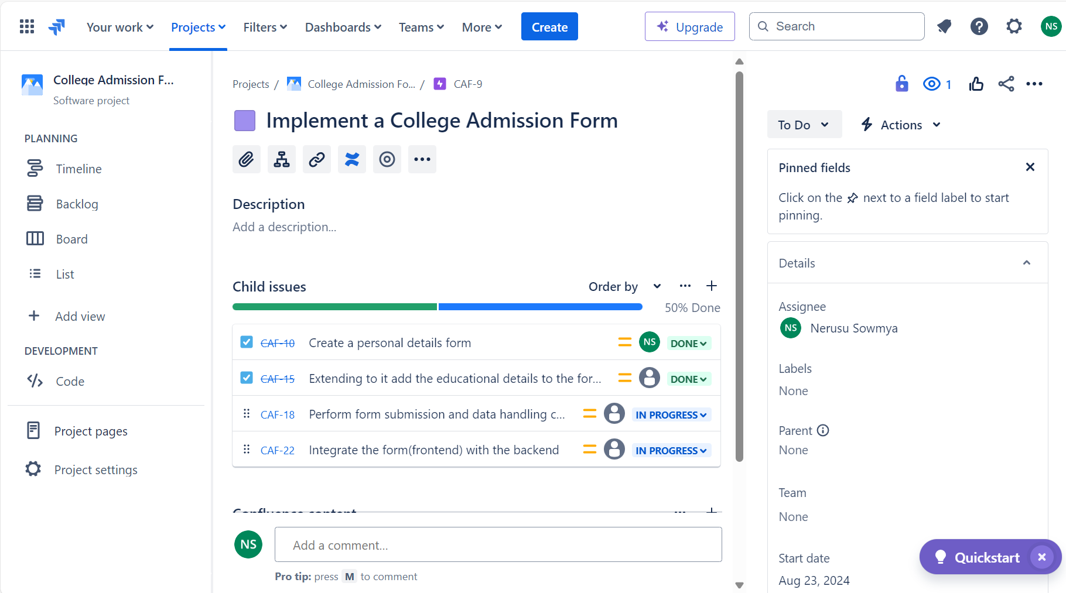
JIRA DASHBOARD
1.Creating an epic and tasks

Slide 21
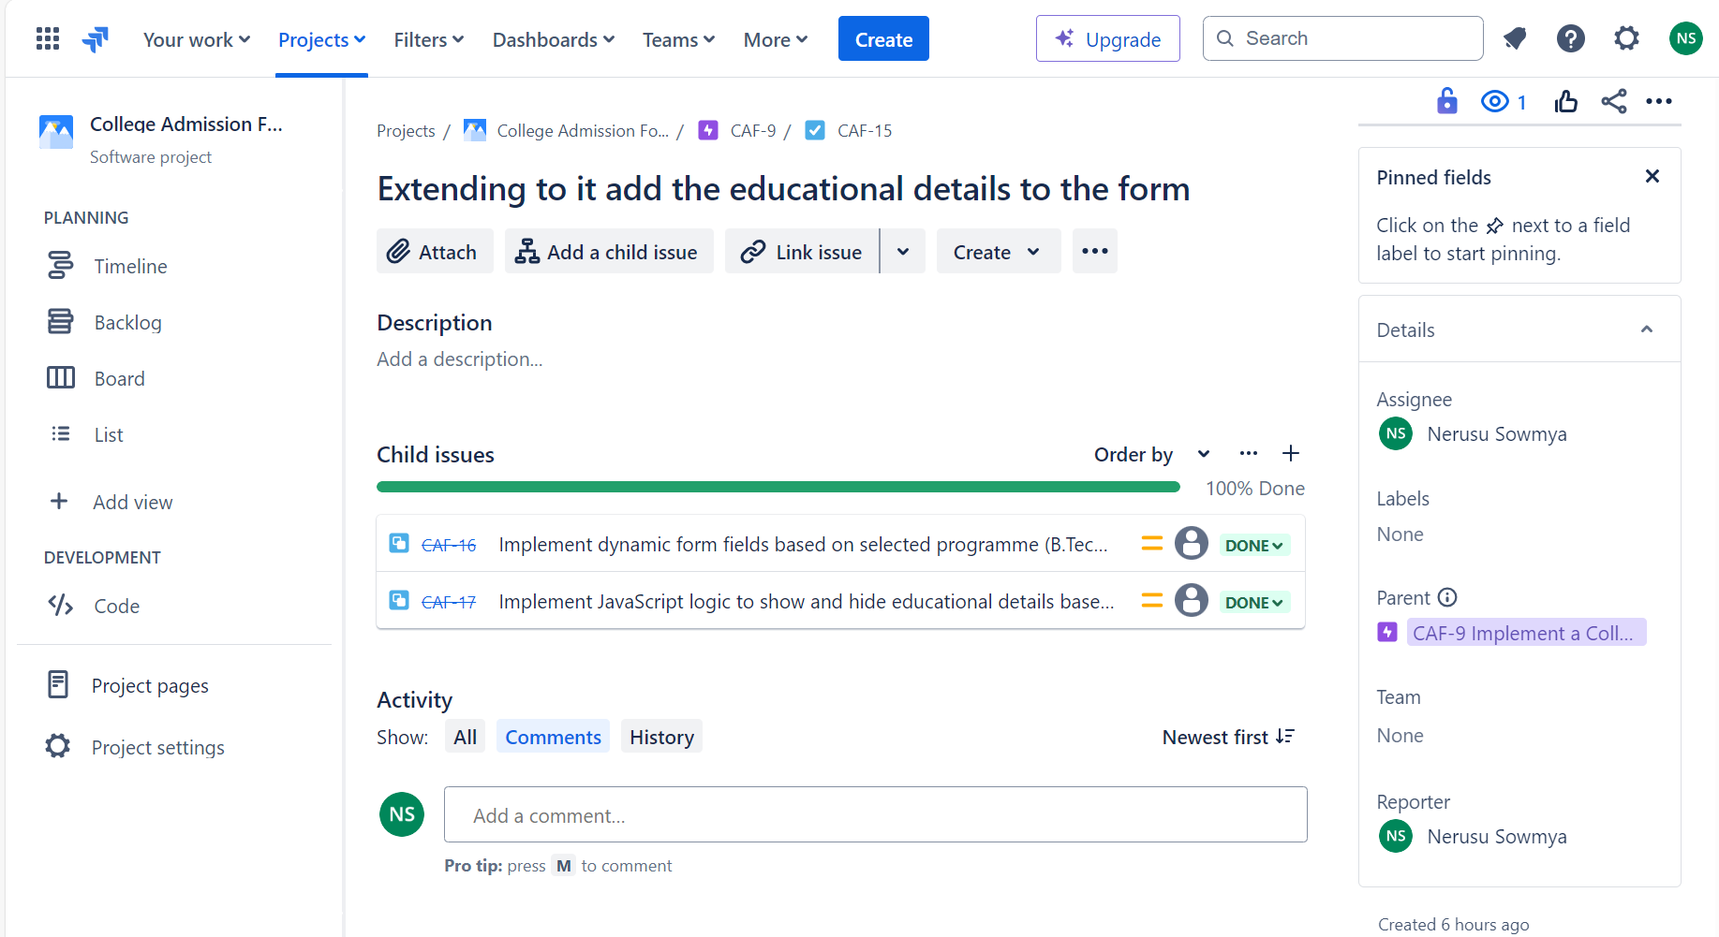
JIRA DASHBOARD
2.Creating the subtasks and updating the progress(In Progress, Done)

Slide 22
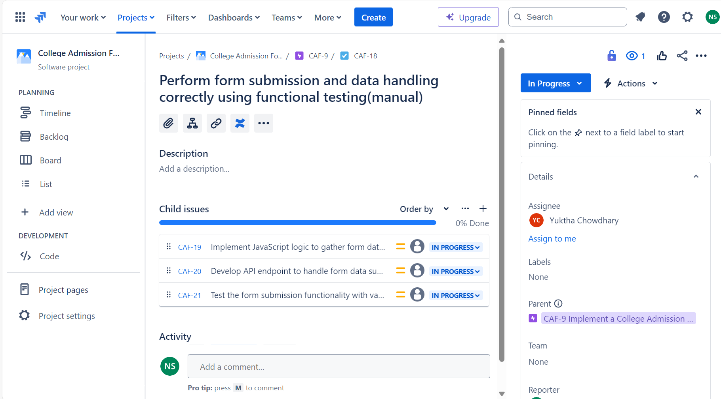
JIRA DASHBOARD
3.Here the subtasks are created and assigned

Slide 23


